Slide 1
January 2022
Maximizing Warehouse Capacity
Colliers Supply Chain Solutions
Notes:
Colliers Campus Deck Outline (Slides):
Welcome to Colliers (with an interchangeable campus /university logo)
Meet the team/presenter’s slide
Who we are/History of Colliers
Map of our geographic presence
Focus areas of our business
D&I and our culture
Community involvement/social impact
Campus Specific Programs we are speaking to – interns, Co-Ops, and full time (can add program placeholders for time being)
Recruitment process timeline
Join our Talent Community today/Follow up Email/Site URL

Slide 2
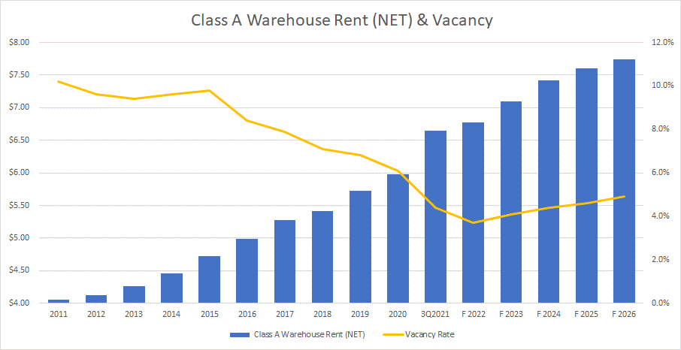
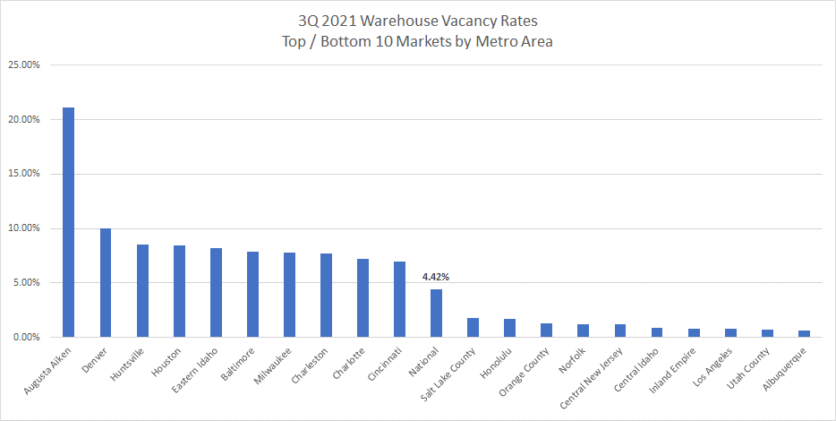
Warehouse Vacancy at Historical Low
Class A Warehouse Rent (NET) & Vacancy
3Q 2021 Warehouse Vacancy Rates Top/Bottom 10 Markets by Metro Area
Source: Colliers
Source: Colliers
Facility relocation no longer an easy option
Rising rent, decreasing capacity
Build-to-Suit capacity already spoken for
Optimized space utilization a “new coin in the realm”

Slide 3
An Age-Old Problem Warehouse Space Constraints
Warehouse Overflow
#1 complaint by supply chain managers
Rarely resolved the right way
Creates safety and inventory control risk
Common Solutions
Storage trailers
Storage containers
Lease extensions
Expansion to a larger facility

Slide 4
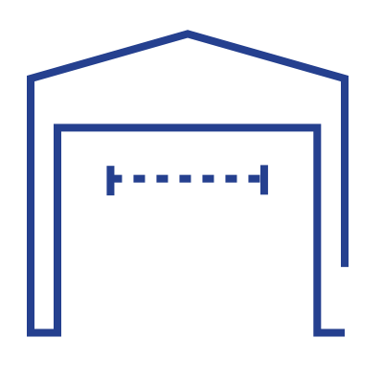
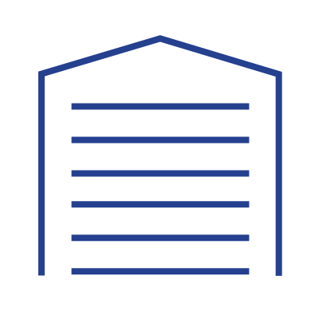
Potential Solutions
Inventory Right-Sizing
Alternatives vary in terms of cost, implementation difficulty, time to completion and warehouse capacity lift
Most options can be funded via OPEX vs. CAPEX
Most options do not require technical / engineering capability
Flex Warehousing
Increased
Warehouse
Capacity
Warehouse Upfitting / Retrofitting
Modular Warehouses

Slide 5
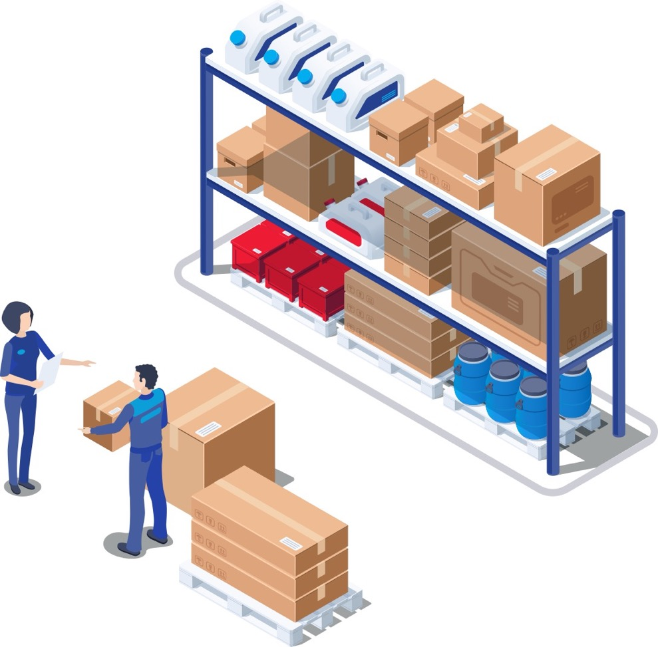
Inventory Management Options Tactical & Strategic
“We are out of space….”
(Tactical) Solution Alternatives
Remove obsolete and non-sellable inventory
Quarterly inventory write-downs
Balance inventory supply with demand
“You’re not out of space … you have too much inventory.”
(Strategic) Solution Alternatives
Vendor Managed Inventory (VMI)
Order postponement to minimize pack & hold
Cross-docking
Vendor drop-shipping / DC bypass

Slide 6
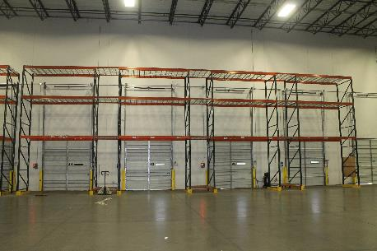
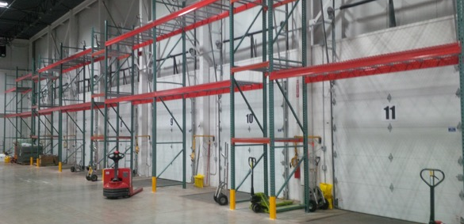
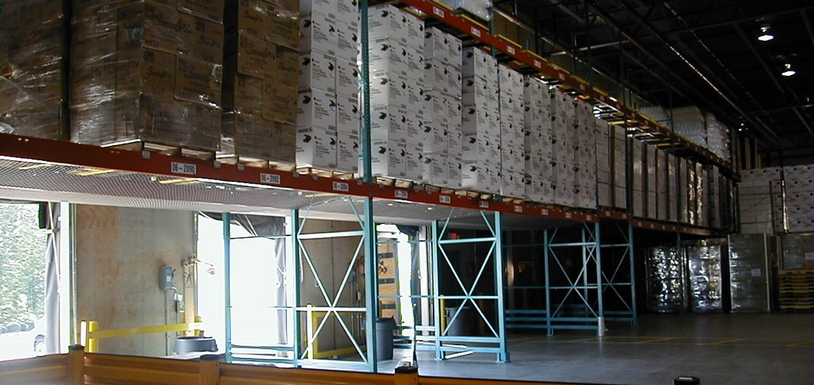
Warehouse Uplift Options Racking Dock Doors
Implementation Difficulty: Low
6-9 pallet capacity per dock door
Common use - pallets, dunnage, packing materials and office supplies
Additional use – Finished goods pack & hold, bulk raw materials
Alternative to bulk floor storage which opens space for additional storage racks

Slide 7
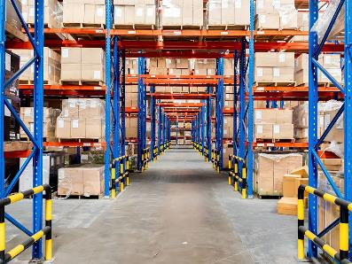
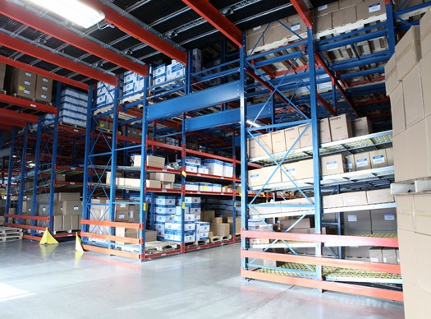
Warehouse Uplift Options Tunneling Rack Cross-Aisles
Implementation Difficulty: Low
6-12 pallet capacity per bay facing
Increase vertical cube utilization
Common use – finished goods inventory
Pallet capacity determined by cross-aisle width and building clear height

Slide 8
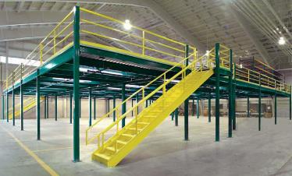
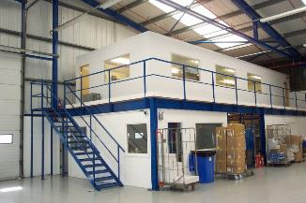
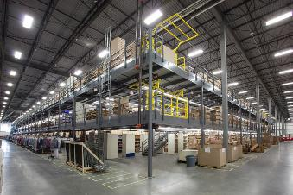
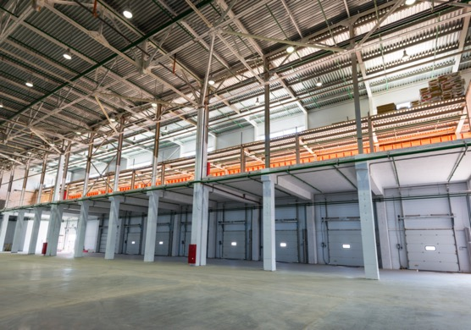
Warehouse Uplift Options Mezzanines
Implementation Difficulty: Low / Medium
Common use – Vertical expansion of pick modules, pallet / general storage above pick modules, shipping / receiving work areas and administrative offices
Additional use – Finished goods pack & hold
Candidate solution for areas with unused vertical space

Slide 9
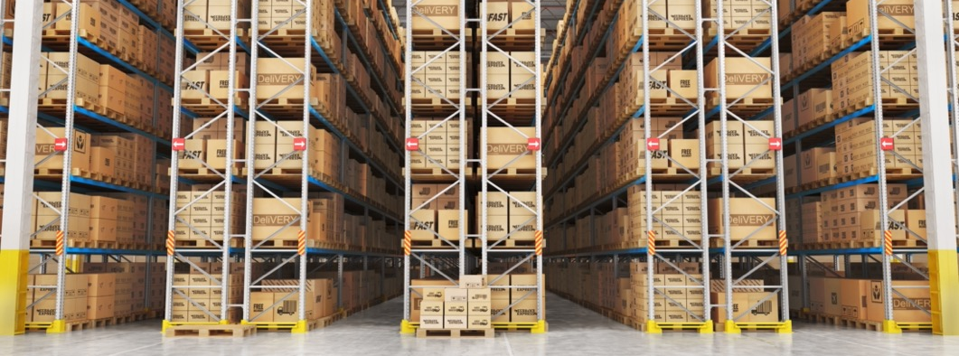
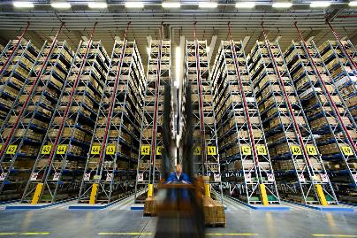
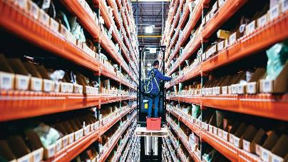
Warehouse Retrofit Options Migrate from Wide Aisles to Very Narrow Aisles (VNA)
Implementation Difficulty: High
Requires different forklift vehicles (e.g. Order pickers, turret trucks or articulated forklifts)
Requires a wire guidance system to avoid upright collision
Requires one-way vehicle routing for inventory put away and order picking
Requires understanding of DC design principles
20-30% storage capacity lift
Common use – finished goods inventory

Slide 10
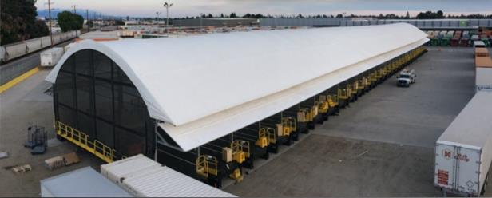
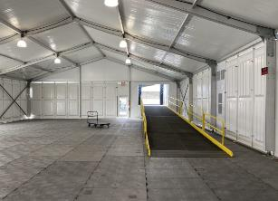
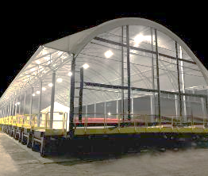
Third-Party Alternatives Modular / Pop-Up Warehousing
Implementation Difficulty: Medium
Common use – Inventory storage (all types), order fulfillment and cross-docking
Rapid construction time
High configurability and transferability
Concrete pouring not required
Requires raw land or open industrial space
Permitting requirements vary by municipality

Slide 11
Third-Party Alternatives On-Demand / Flex Warehousing
Service Model – “Industrial Airbnb”
Flexible contract duration / terms vs. traditional 3PL
Several established industry players and some emerging participants
Order fulfillment, inventory management and value-added services provided
Services supported by Warehouse Management Systems (WMS)

Slide 12
Roadmap to Increased Warehouse Capacity
High
Flex warehousing
Modular / pop-up warehouses
Remove obsolete& non-sellable inventory
Vendor Managed Inventory
Balance inventory supply with demand
(SIOP)
Quarterly inventory write-downs
Incremental Warehouse Capacity
Order cross-docking
VNA
Tunneling Rack Travel Aisles
Vendor dropship / DC bypass
Mezzanines
Postpone orders to minimize pack & hold
Racking dock doors
Do now
Do Next
Do Later
Low
Complexity / Difficulty
High

Slide 13
For more information, contact:
Brewster Smith Head of Supply Chain Solutions brewster.Smith@colliers.com +1 202.250.4269

